Slide 1
ADVENTURE WORK
PRESENTED BY
KAREN SHOKUNBI

Slide 2
OUTLINE
INTRODUCTION
DATABASE OVERVIEW
AIM AND OBJECTIVES
METHODOLOGY
ANALYSIS INSIGHTS
RECOMMENDATION AND CONCLUSION

Slide 3
INTRODUCTION
The Adventure Works 2019 database is a sample database commonly used for learning and demonstrating SQL, data analysis, and database design. It was developed by Microsoft as part of its SQL Server documentation and training resources. The database is a widely recognized learning tool in the SQL and data analytics communities.
Adventure Works offers realistic business scenarios and datasets that allow learners, developers, and analysts to practice and apply database concepts in a practical context. The 2019 version builds upon previous iterations, incorporating updates to schemas and data to reflect modern business processes and technologies.

Slide 4
DATABASE OVERVIEW
The database simulates a fictitious manufacturing company, Adventure Works Cycles, that produces and sells sport wears, bicycles, bike component, and accessories.
The database contains realistic Business Data on customers, orders, sales, products, employees, and suppliers. It also mimics the operations of a global enterprise, providing diverse scenarios for querying and analysis

Slide 5
AIM AND OBJECTIVES
AIM
The aim of the project is to help students explore database management and analysis within a simulated business scenario, thereby providing a realistic and comprehensive environment for hands-on learning of SQL, data warehousing, and business intelligence concepts.

Slide 6
OBJECTIVES
To enhance SQL skills for querying, joining, and summarizing data.
To realistic datasets covering multiple business areas, including sales, production, human resources, and finance, for practical analysis and reporting.
To understand and apply concepts of fact and dimension tables for a more efficient, analytical database schema.
To improve students knowledge on analyzing data trend, generating reports, and building dashboard using SQL, Excel and PowerBI.

Slide 7
METHODOLOGY
The methods employed in this project included data cleaning using SQL to ensure data accuracy and consistency, data warehousing with Excel for efficient organization and storage, and data visualization with Power BI to create clear and actionable insights.

Slide 8
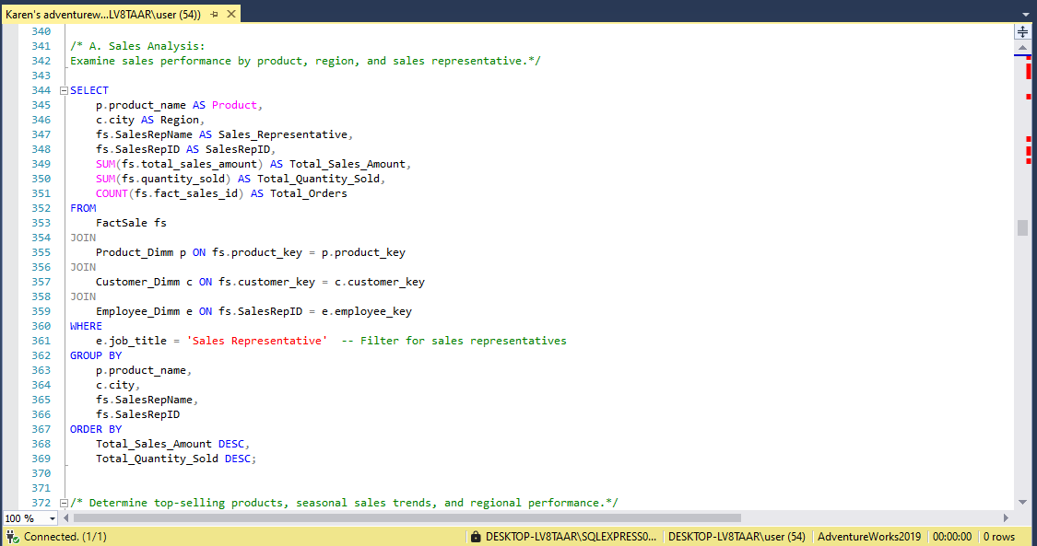
DATA CLEANING WITH SQL
In SQL, different function like update, select, create, join, aggregate.

Slide 9
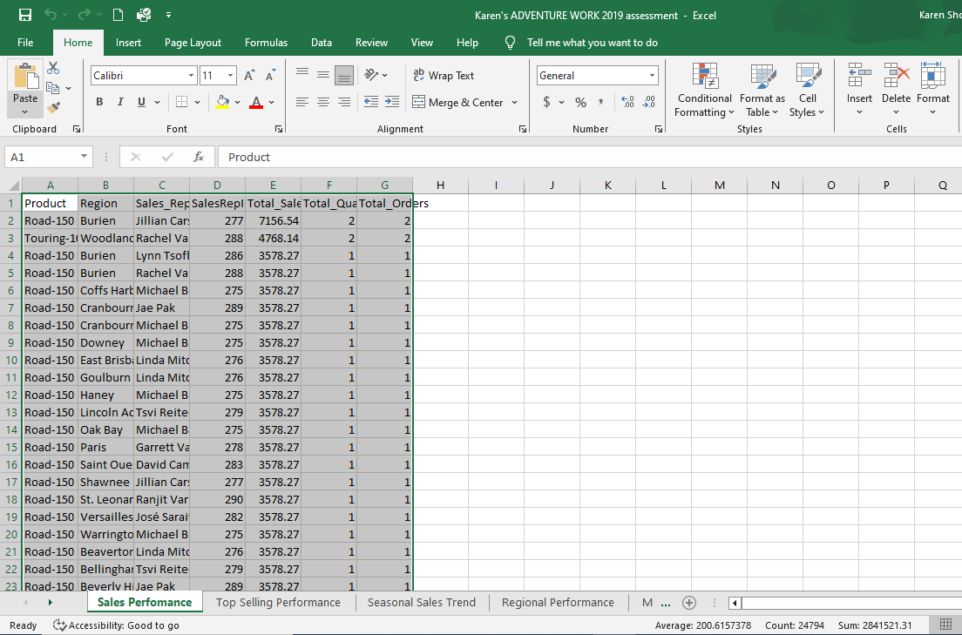
DATA WAREHOUSING WITH EXCEL
After the data was cleaned using SQL tool, necessary tables were moved to excel for data warehousing before being moved to PowerBI for visualization.

Slide 10
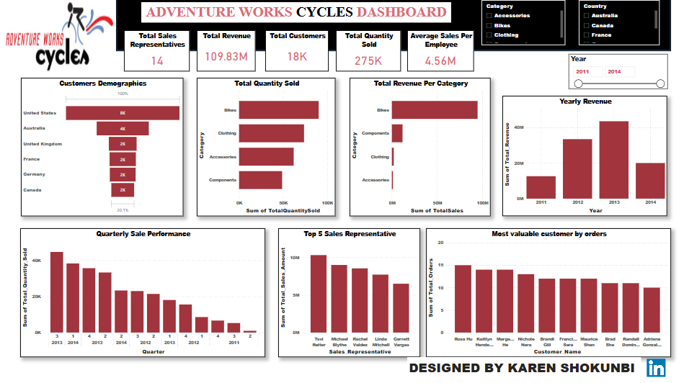
ANALYSIS INSIGHTS

Slide 11
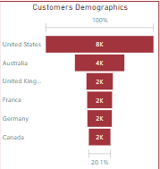
CUSTOMERS DEMOGRAPHICS
Adventure Works Cycles has a total of 18,000 customers distributed across six countries: the United States of America, Australia, the United Kingdom, Germany, France, and Canada. The United States accounts for the largest share of customers at 43.4%, while Canada represents the smallest share, with just 8.72% of the total customer base.

Slide 12
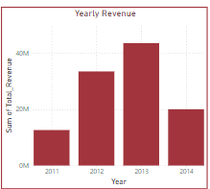
YEARLY REVENUE
Adventure Works Cycles generated a total revenue of $109,846,380 between 2011 and 2014, with 2013 recording the highest revenue of $43,622,476.30.

Slide 13
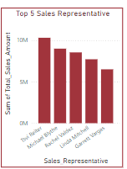
EMPLOYEE PERFORMANCE
The sales department at Adventure Works Cycles consists of 14 sales representatives. The top five performers include Tsvi Reiter, who generated a total revenue of $11,309,000, followed by Michael Blythe with $9,996,108.95, Rachel Vandez with $9,524,493.26, Linda Mitchell with $8,714,217, and Garrett Vargas with $7,500,238.

Slide 14
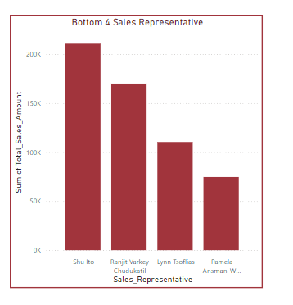
EMPLOYEE PERFORMANCE
The bottom four sales representatives are Pamela Ansman-Wolfe, who generated a total revenue of $746,670; Lynn Tsoflias, with $1,104,100; Ranjit Varkey Chudukkattil, with $1,700,670; and Shu Ito, with $2,107,770.

Slide 15
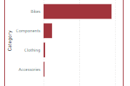
MARKET TREND AND REVENUE TRACKING
Adventure Cycles has a total of 288 products which are in four(4) different categories; Bikes, Component, Clothings and Accessories.
The bike categories generated the most revenue of $94,651,173 followed by component categories which generated a total of $11,786,871.40, followed by clothing categories generated a total of $2,120,542 while accessories category generated the least which is a total of $1,272,074.

Slide 16
KEY ANALYSIS INSIGHTS
The United States has the largest customer base, representing 43.4% of total customers, indicating it is the most critical market.
Canada, with only 8.72% of the customer base, offers potential for growth as it is currently underrepresented.
Adventure Works Cycles achieved a total revenue of $109,846,380 between 2011 and 2014, with 2013 being the highest-earning year at $43,622,476.30.
A significant performance gap exists between the top and bottom sales representatives, with the highest performer generating $11,309,000 and the lowest generating $746,670.
The sales department comprises 14 representatives, but revenue generation is unevenly distributed, showing potential inefficiencies or disparities in performance.

Slide 17
RECOMMENDATIONS
Tailor strategies to the U.S. market, which represents the largest customer base, to maximize revenue.
.
Target campaigns to grow the Canadian customer base, which currently has the smallest share.
Tailor strategies to the U.S. market, which represents the largest customer base, to maximize revenue.
Focus on expanding high-demand products and explore partnerships or new offerings to diversify revenue..
Provide additional training and coaching to help the bottom four representatives improve.

Slide 18
CONCLUSION
The analysis was conducted using a comprehensive approach to data management and visualization. Data cleaning was performed using SQL to ensure accuracy and reliability, followed by data warehousing in Excel for efficient storage and organization. Finally, insights were visualized using Power BI, providing clear and actionable representations of the data. These methods enabled a thorough understanding of customer distribution, revenue trends, and sales performance, forming the basis for strategic recommendations to drive growth and optimize performance at Adventure Works Cycles.

Slide 19
THANK
YOU

